Slide 1

Thank You
This PowerPoint document contains the images that you requested.
Copyright Notice
All Online Service materials, including, without limitation, text, pictures, graphics and other files and the selection and arrangement thereof are copyrighted materials of Ovid or its licensors, all rights reserved. Except for the Authorized Use specified above, you may not copy, modify or distribute any of the Online Service materials. You may not "mirror" any material contained on this Online Service on any other server. Any unauthorized use of any material contained on this Online Service may violate copyright laws, trademark laws, the laws of privacy and publicity and communications regulations and statutes.

Slide 2
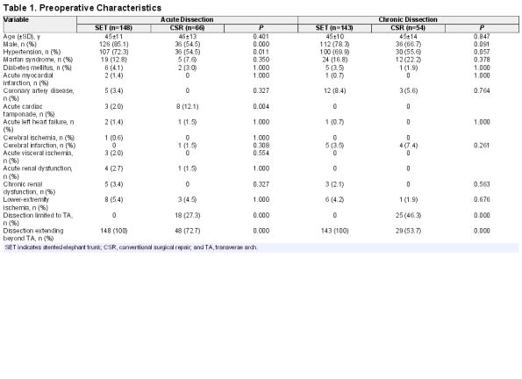
Table 1
Total Arch Replacement Combined With Stented Elephant Trunk Implantation: A New "Standard" Therapy for Type A Dissection Involving Repair of the Aortic Arch?.
Sun, LiZhong; Qi, RuiDong; Zhu, JunMing; Liu, YongMin; Zheng, Jun
Circulation. 123(9):971-978, March 8, 2011.
DOI: 10.1161/CIRCULATIONAHA.110.015081
Table 1 . Preoperative Characteristics
© 2011 American Heart Association, Inc. Published by American Heart Association.
2

Slide 3
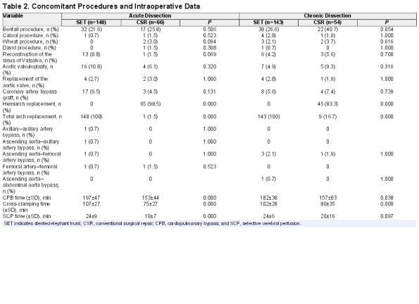
Table 2
Total Arch Replacement Combined With Stented Elephant Trunk Implantation: A New "Standard" Therapy for Type A Dissection Involving Repair of the Aortic Arch?.
Sun, LiZhong; Qi, RuiDong; Zhu, JunMing; Liu, YongMin; Zheng, Jun
Circulation. 123(9):971-978, March 8, 2011.
DOI: 10.1161/CIRCULATIONAHA.110.015081
Table 2 . Concomitant Procedures and Intraoperative Data
© 2011 American Heart Association, Inc. Published by American Heart Association.
3

Slide 4
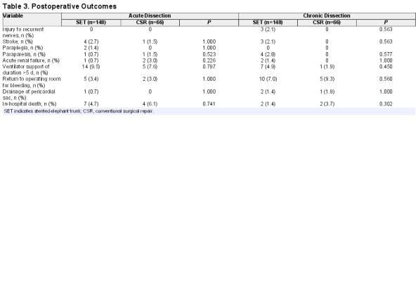
Table 3
Total Arch Replacement Combined With Stented Elephant Trunk Implantation: A New "Standard" Therapy for Type A Dissection Involving Repair of the Aortic Arch?.
Sun, LiZhong; Qi, RuiDong; Zhu, JunMing; Liu, YongMin; Zheng, Jun
Circulation. 123(9):971-978, March 8, 2011.
DOI: 10.1161/CIRCULATIONAHA.110.015081
Table 3 . Postoperative Outcomes
© 2011 American Heart Association, Inc. Published by American Heart Association.
4

Slide 5
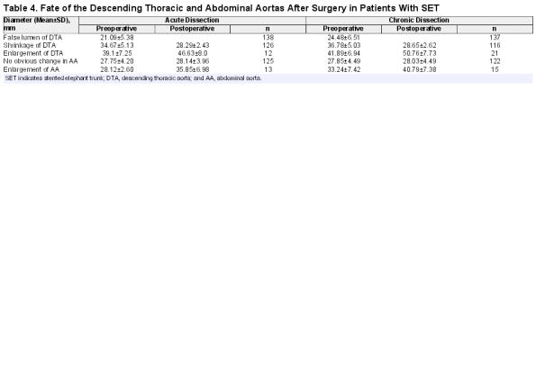
Table 4
Total Arch Replacement Combined With Stented Elephant Trunk Implantation: A New "Standard" Therapy for Type A Dissection Involving Repair of the Aortic Arch?.
Sun, LiZhong; Qi, RuiDong; Zhu, JunMing; Liu, YongMin; Zheng, Jun
Circulation. 123(9):971-978, March 8, 2011.
DOI: 10.1161/CIRCULATIONAHA.110.015081
Table 4 . Fate of the Descending Thoracic and Abdominal Aortas After Surgery in Patients With SET
© 2011 American Heart Association, Inc. Published by American Heart Association.
5

Slide 6
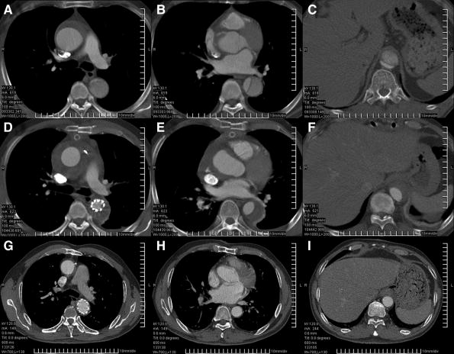
Figure 1
Total Arch Replacement Combined With Stented Elephant Trunk Implantation: A New "Standard" Therapy for Type A Dissection Involving Repair of the Aortic Arch?.
Sun, LiZhong; Qi, RuiDong; Zhu, JunMing; Liu, YongMin; Zheng, Jun
Circulation. 123(9):971-978, March 8, 2011.
DOI: 10.1161/CIRCULATIONAHA.110.015081
Figure 1 . Computed tomography of a patient with chronic type A dissection before surgery (A through C) and 2 weeks (D through F) and 53 months (G through I) after surgery. The true lumen was compressed by a huge false lumen (A through C). Thrombosis of the false lumen was observed around the stented graft (D), distal to the edge of the stented graft (E), and at the diaphragmatic level (F) 2 weeks after surgery. The true lumen was enlarged (D through F), and the surgical stent graft was compressed by the false lumen (D). The false lumen thrombosis was reabsorbed; the stented graft expanded to its full diameter; and the true lumen in the descending aorta resumed completely (G through I). After remodeling of the 2 layers of the dissected aortic wall, shrinkage of the entire aorta was seen, and the distal aorta returned to nearly or completely normal size (G through I).
© 2011 American Heart Association, Inc. Published by American Heart Association.
6

Slide 7
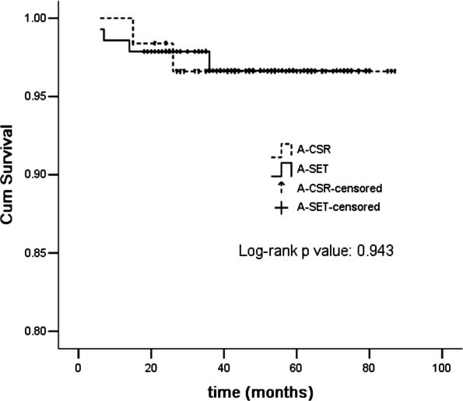
Figure 2
Total Arch Replacement Combined With Stented Elephant Trunk Implantation: A New "Standard" Therapy for Type A Dissection Involving Repair of the Aortic Arch?.
Sun, LiZhong; Qi, RuiDong; Zhu, JunMing; Liu, YongMin; Zheng, Jun
Circulation. 123(9):971-978, March 8, 2011.
DOI: 10.1161/CIRCULATIONAHA.110.015081
Figure 2 . The survivor functions (excluding in-hospital deaths) were not significantly different between the stented elephant trunk (SET) group and conventional surgical repair (CSR) group in patients with acute (A) dissection (P=0.943).
© 2011 American Heart Association, Inc. Published by American Heart Association.
7

Slide 8
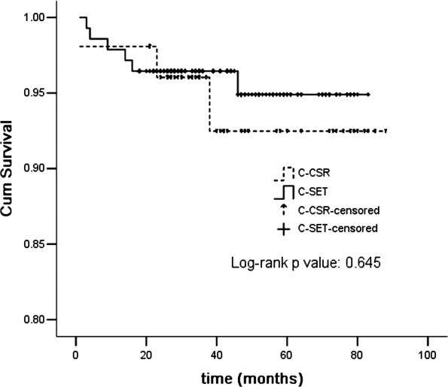
Figure 3
Total Arch Replacement Combined With Stented Elephant Trunk Implantation: A New "Standard" Therapy for Type A Dissection Involving Repair of the Aortic Arch?.
Sun, LiZhong; Qi, RuiDong; Zhu, JunMing; Liu, YongMin; Zheng, Jun
Circulation. 123(9):971-978, March 8, 2011.
DOI: 10.1161/CIRCULATIONAHA.110.015081
Figure 3 . The survivor functions (excluding in-hospital deaths) showed no significant difference between the stented elephant trunk (SET) group and conventional surgical repair (CSR) group in patients with chronic (C) dissection (P=0.645).
© 2011 American Heart Association, Inc. Published by American Heart Association.
8

Slide 9
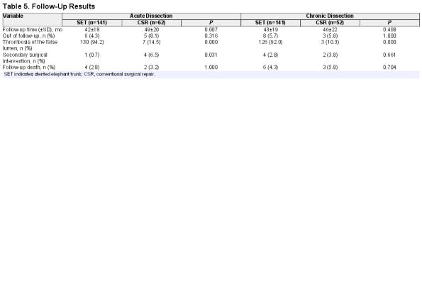
Table 5
Total Arch Replacement Combined With Stented Elephant Trunk Implantation: A New "Standard" Therapy for Type A Dissection Involving Repair of the Aortic Arch?.
Sun, LiZhong; Qi, RuiDong; Zhu, JunMing; Liu, YongMin; Zheng, Jun
Circulation. 123(9):971-978, March 8, 2011.
DOI: 10.1161/CIRCULATIONAHA.110.015081
Table 5 . Follow-Up Results
© 2011 American Heart Association, Inc. Published by American Heart Association.
9

